Slide 1
Smart Nozzle Design

Slide 2

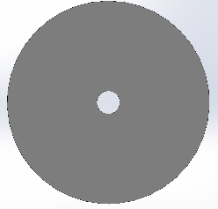
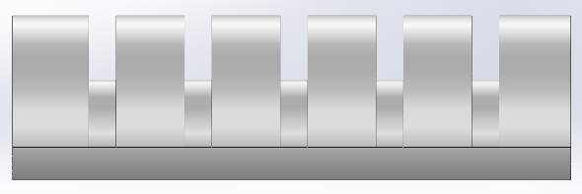
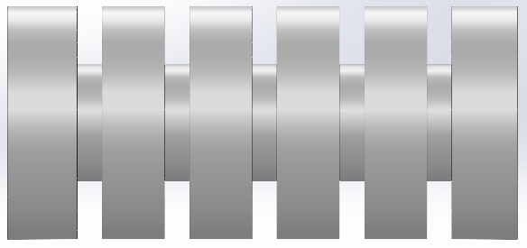
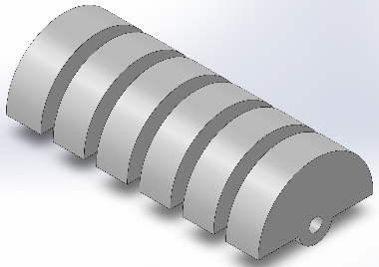
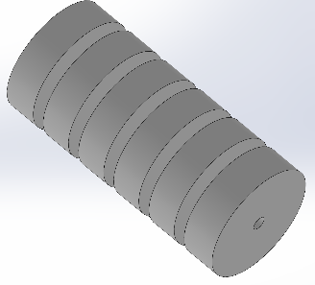
Current Designs sizing &cross section
2 Chamber Model
3 Chamber Model
4 Chamber Model

Slide 3
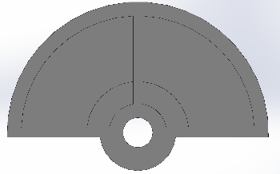
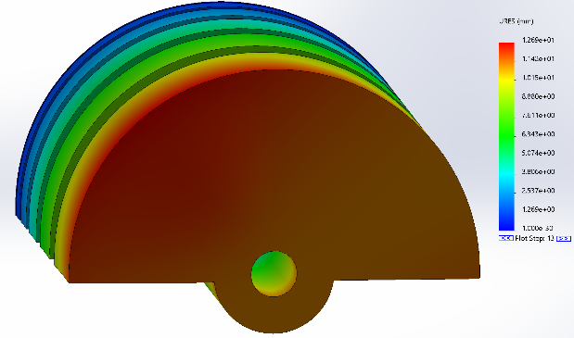
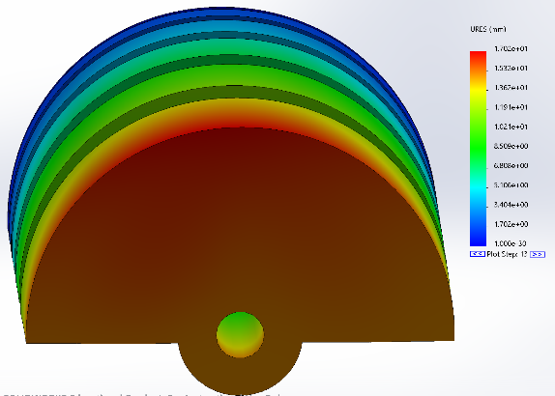
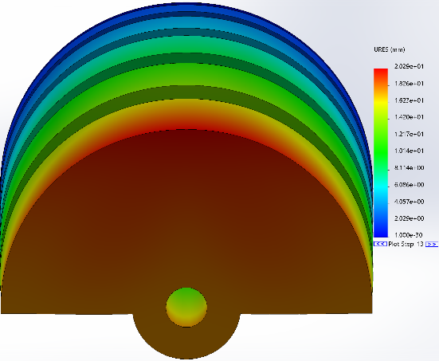
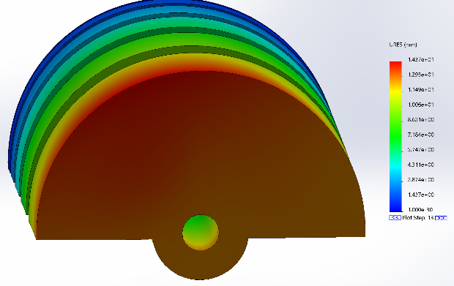
2 Chamber Model
C2 C1
C1 0psi
C2 15psi
C1 10psi
C2 15psi
C1 5psi
C2 15psi
C1 15psi
C2 15psi

Slide 4
2 Chamber Deformation Chart
C2 C1
(x,y) disp. (mm) | C1 0 psi | C1 5 psi | C1 10 psi | C1 15 psi | C1 20 psi
C2 0 | (0, 0)
C2 5 psi | (2.637, -3.011) | (0, -5.986)
C2 10 psi | (4.794, -6.099) | (2.461, -9.117) | (0, -11.56)
C2 15 psi | (7.282, -9.271) | (4.931, -12.35) | (2.551, -15.62) | (0, -17.79)
C2 20 psi | (9.835, -12.51) | (7.468, -15.68) | (5.065, -19.02) | (2.633, -22.44) | (0, -24.28)
C1-10 C2-20 failed at 72.8%
C1-15 C2-20 failed at 70.2%
C1-20 C2-20 failed at 70.2%

Slide 5
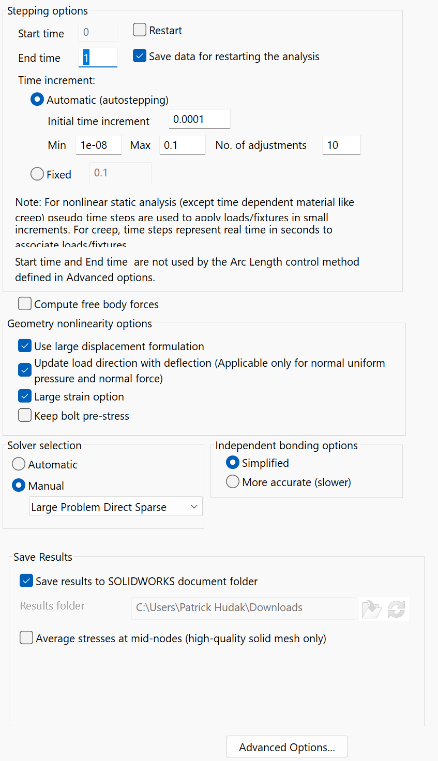
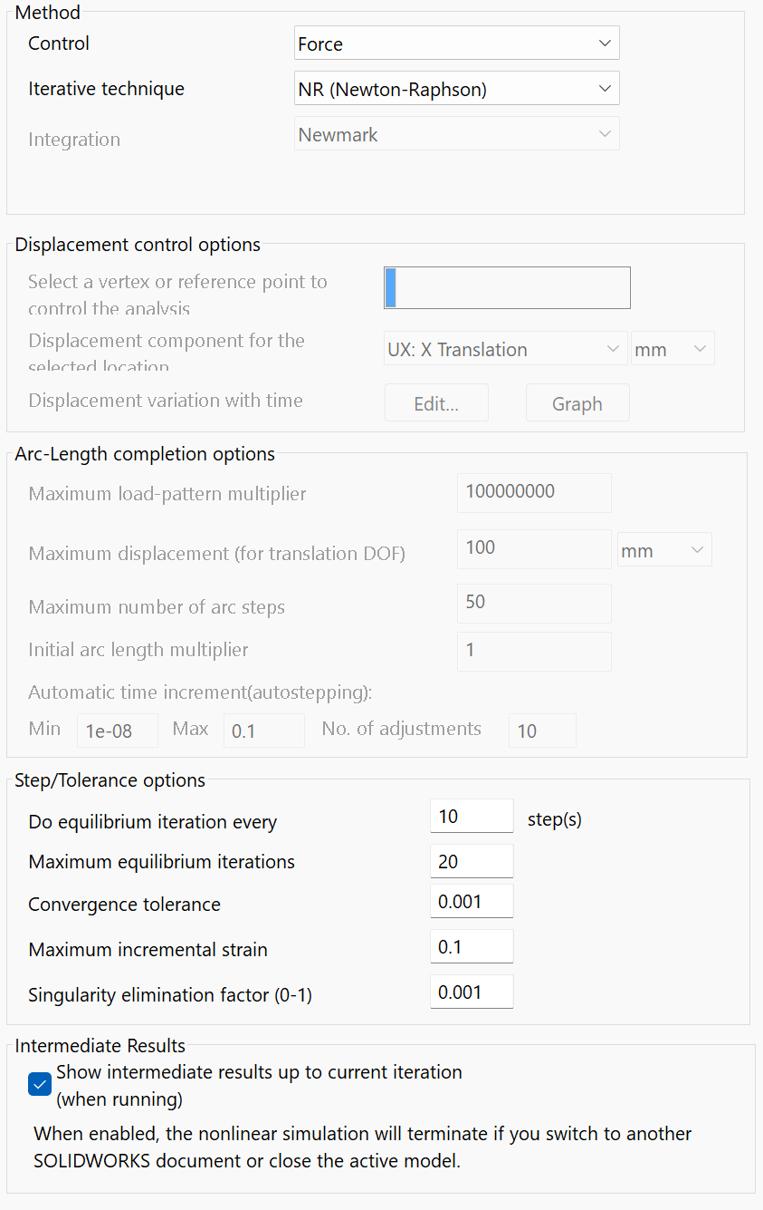
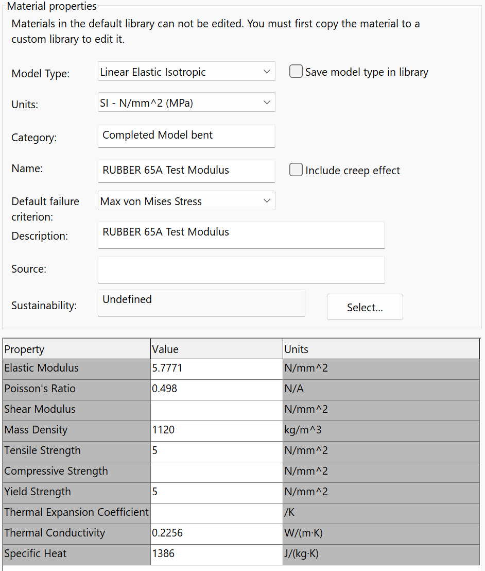
Simulation and Material Properties

Slide 6
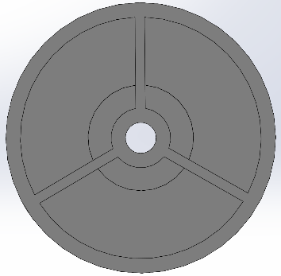
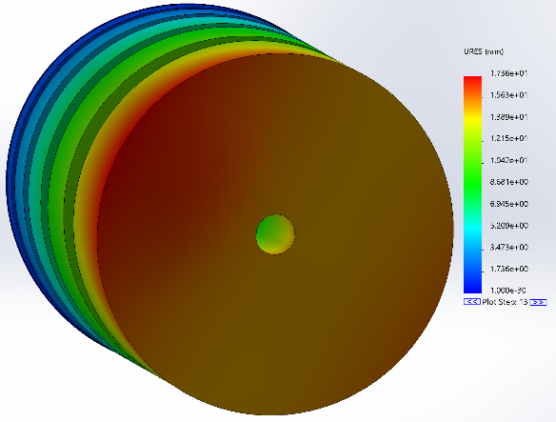
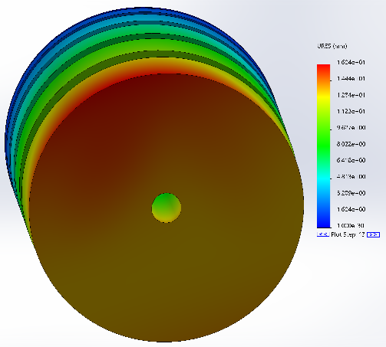
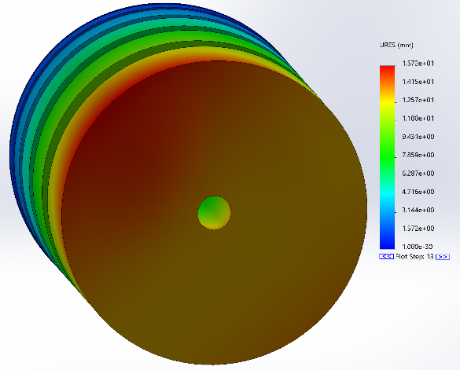
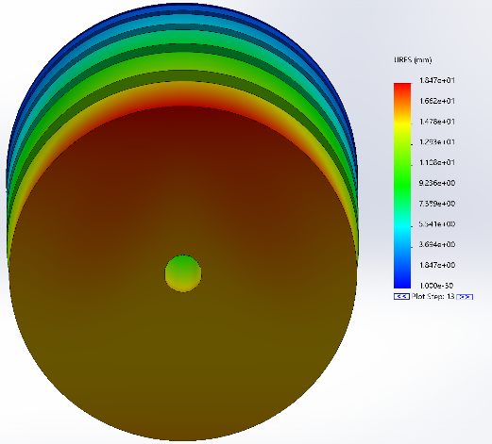
3 Chamber Model
C2 C1
C1 0psi
C2 15psi
C1 10psi
C2 15psi
C1 5psi
C2 15psi
C1 15psi
C2 15psi

Slide 7
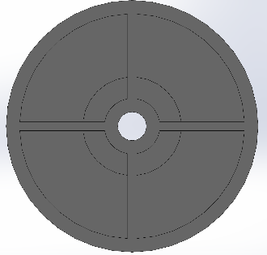
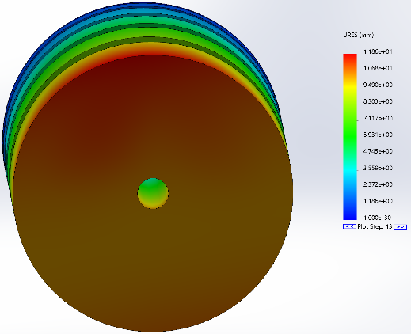
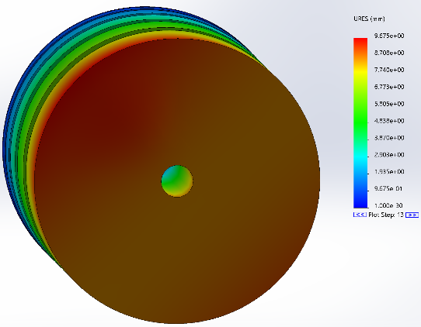
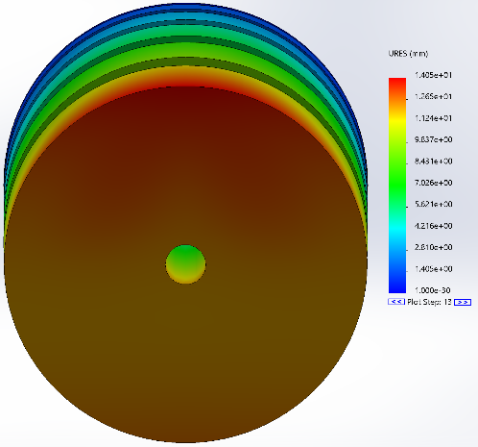
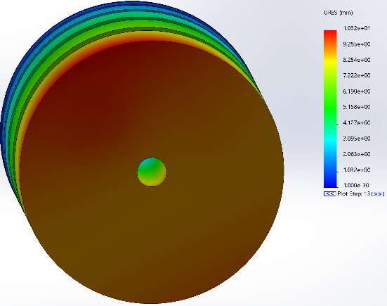
4 Chamber Model
C2 C1
C1 0psi
C2 15psi
C1 10psi
C2 15psi
C1 5psi
C2 15psi
C1 15psi
C2 15psi

Slide 8
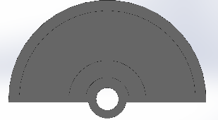
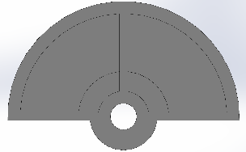
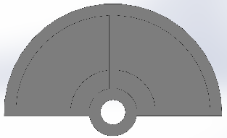
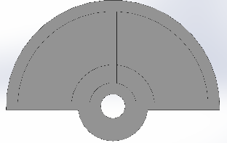
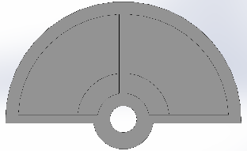
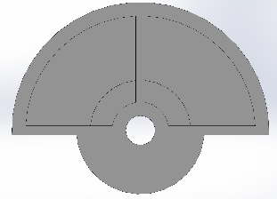
Design Strategy
Design models using thickness to generate more stiffness/flexibility
Have already explored on the 2 chamber model
Would this approach be easier to print?

Slide 9
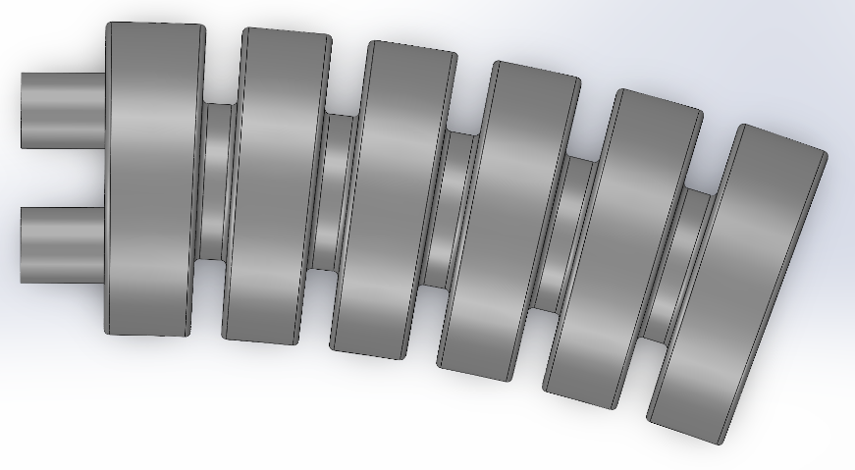
Design Strategy
Design models using design elements to stiffen nozzle while saving on printing cost
Have briefly explored on the 4 chamber model
Would this approach be more complicated to print?

Slide 10
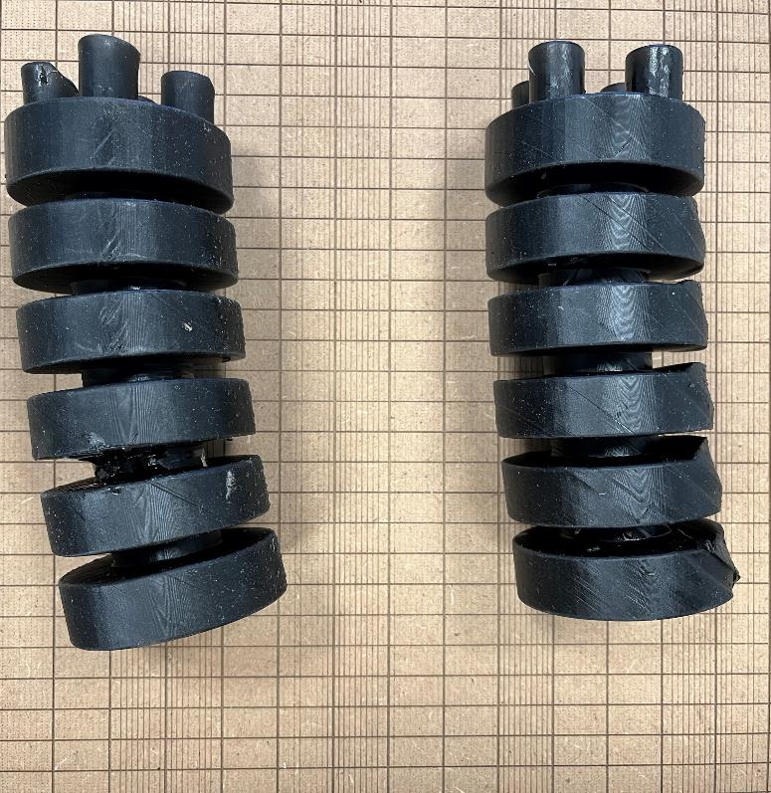
Printing Questions
Print Quality? Related to parameter selection?
Level of graininess?
Bending of the model? Supports?
What can we implement in our designs that will promote the most robust design?

Slide 11
Additional discussion/questions/concerns
Embrace variety around the two chamber model. Larger filets and rounds. Donuts instead of burgers. 4 chambers . 6 chambers but small. Brat size instead of white claw size. Get varieties of each
Try to run water through the model
Look at cfd fluid give this a few hours

Slide 12
3 Chamber Results
(x,y) disp. (mm) | C1 0psi | C1 5psi | C1 10psi | C1 15psi | C1 20psi
C2 0psi | 0 |  | (-8.825, -5.218)
C2 5psi | (4.360, -2.480) | (0, -5.003)
C2 10psi | (8.946, -5.095) | (4.666, -7.707) | (0, 10.52)
C2 15psi | (13.77, -7.842) | (9.423, -10.56) | (4.595, -13.46) | (0, -16.58)
C2 20psi | (18.95, -10.75) | (14.43, -13.58) | (9.884, -16.54) | (5.242, -19.78) | (0, -23.17)
C1-15 C2-20 failed at 80.2%
C1-20 C2-20 failed at 80.5%

Slide 13
4 Chamber Results
(x,y) disp. (mm) | C1 0psi | C1 10psi | C1 15psi | C1 20psi | C1 25psi | C1 30psi
C2 0psi | (0,0) | (-4.142,-4.162)
C2 10psi | (4.126,-4.135) | (0,-8.244)
C2 15psi | (6.285,-6.303) | (2.205,-10.44) | (0,-12.69)
C2 20psi | (8.515,-8.451) | (4.409,-12.71) | (2.292,-14.99) | (0,-17.34)
C2 25psi | (10.81,-10.85) | (6.86,-15.07)
C2 30psi | (13.19,-13.24) | (9.036,-17.51)
C1-10 C2-25 failed at 82.7%
C1-10 C2-30 failed at 70.5%
C1-0 C2-30 failed at 90.7%

